Slide 1
최근 흥미로운 딥러닝 결과
임도형
2021.08.11

Slide 5
https://www.youtube.com/watch?v=pp7HdI0-MIo

Slide 6
https://www.youtube.com/watch?v=gg0F5JjKmhA

Slide 7
https://www.youtube.com/watch?v=8BTdtShZgkI

Slide 8
https://www.youtube.com/watch?v=pW6nZXeWlGM

Slide 9
https://www.youtube.com/watch?v=PCBTZh41Ris

Slide 10
https://www.youtube.com/watch?v=LikxFZZO2sk

Slide 11
https://www.youtube.com/watch?v=fn3KWM1kuAw

Slide 12
https://www.youtube.com/watch?v=P2uZF-5F1wI

Slide 13
https://www.youtube.com/watch?time_continue=1&v=G63goXc5MyU

Slide 14
https://www.youtube.com/watch?v=Khuj4ASldmU

Slide 15
https://youtu.be/cGycBsawTew?t=7

Slide 16
https://www.youtube.com/watch?v=tlThdr3O5Qo

Slide 17
https://toonme.com/

Slide 18
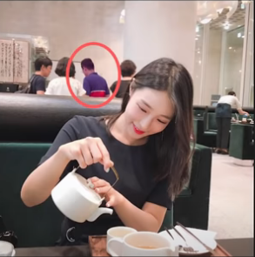
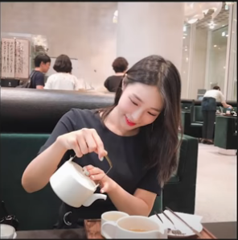
https://youtu.be/u3sI1esTv2k?t=198

Slide 19
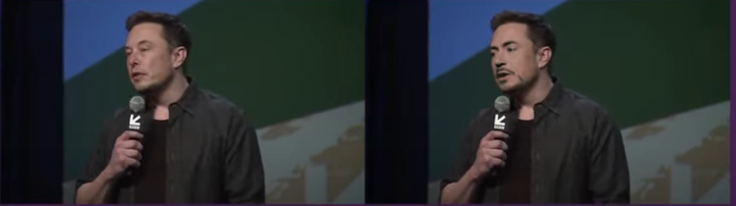
https://www.youtube.com/watch?v=lSM-9RBk3HQ

Slide 20
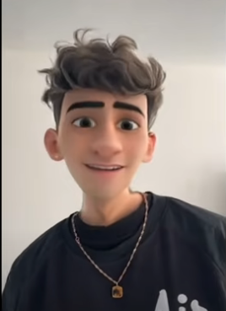
https://youtu.be/-xAzPEvxQz0?t=329

